Slide 1


ECE6810 Final Project
Speech and Audio Processing by Computer
Zeyu Liu

Slide 2
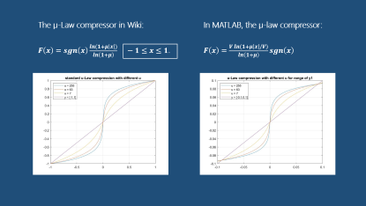
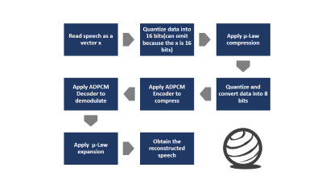
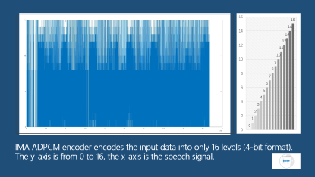
Contents some key points in project
The important code I used:
uencode(), udecode(), compand(), adpcm_encoder(), adpcm_decoder()
µ-Law
Step
Result

Slide 3
Read speech as a vector x
Quantize and convert data into 8 bits
Quantize data into 16 bits(can omit because the x is 16 bits)
Apply μ-Law compression
Apply ADPCM Encoder to compress
Apply ADPCM Decoder to demodulate
Apply μ-Law expansion
Obtain the reconstructed speech

Slide 4
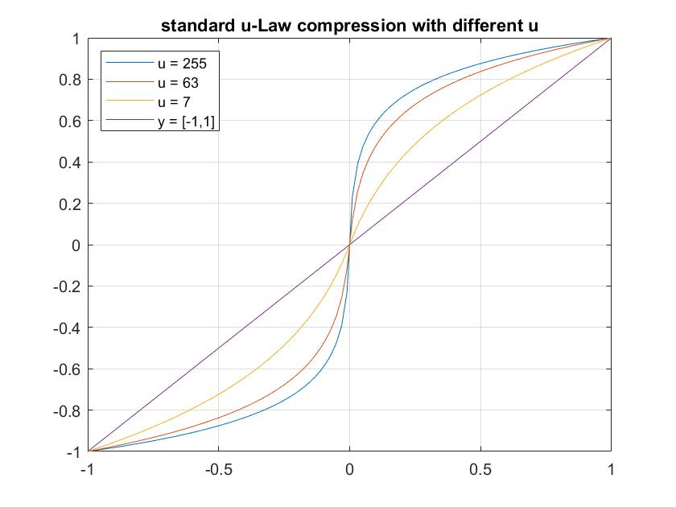
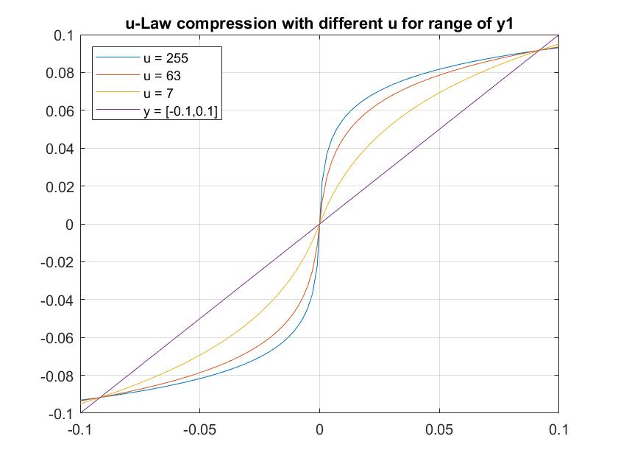


The µ-Law compressor in Wiki:
$F\left(x\right)=sgn\left(x\right)\frac{ln⁡(1+μ\left|x\right|)}{\ln\left(1+μ\right)} −1≤x≤1$.
In MATLAB, the µ-law compressor:
$F\left(x\right)=\frac{V ln⁡(1+μ\left|x\right|/V)}{\ln\left(1+μ\right)}sgn\left(x\right)$

Slide 5
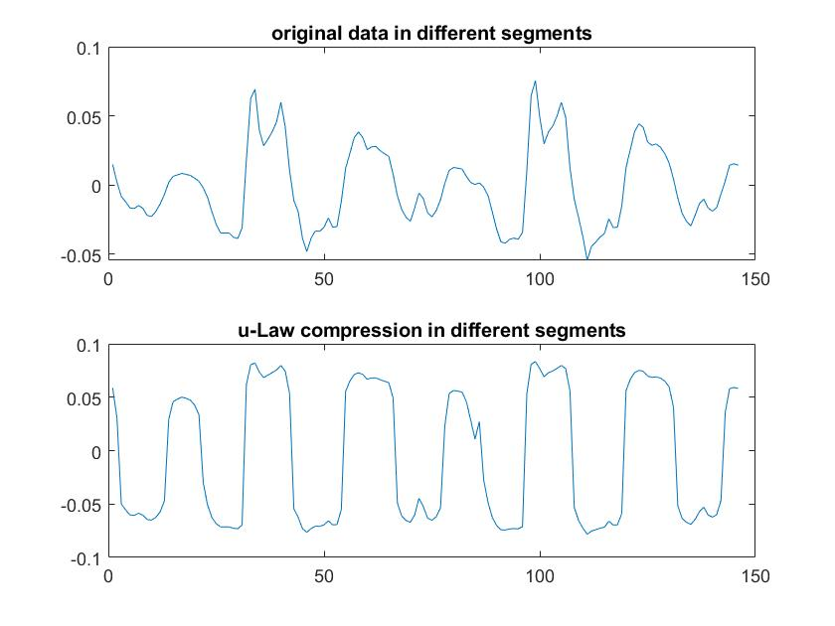
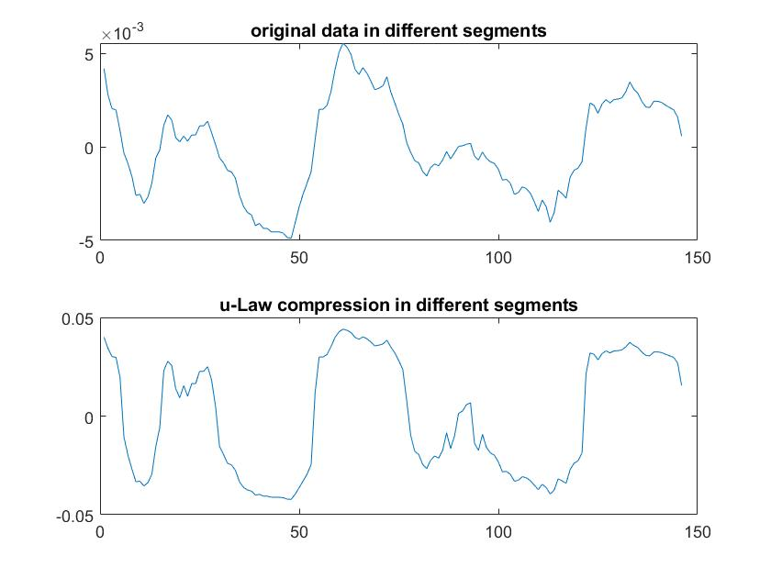
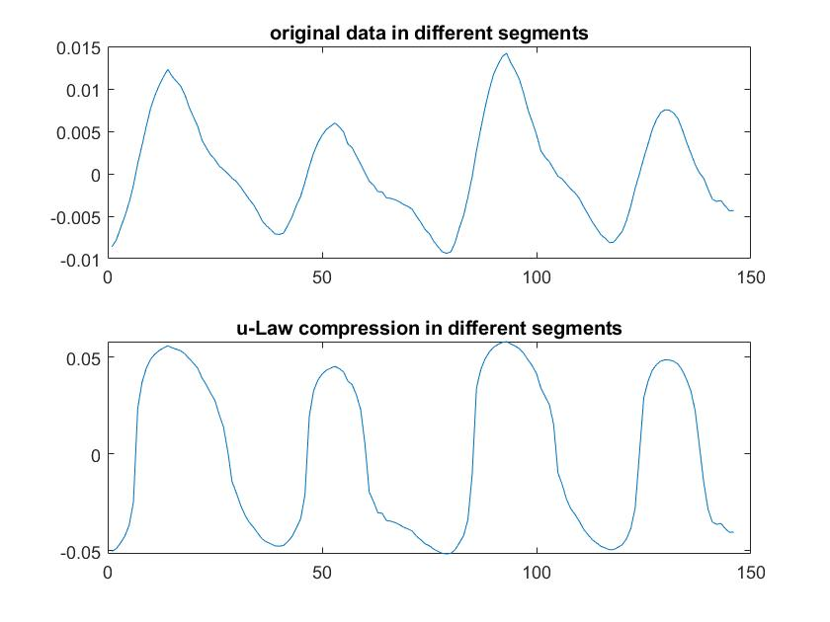
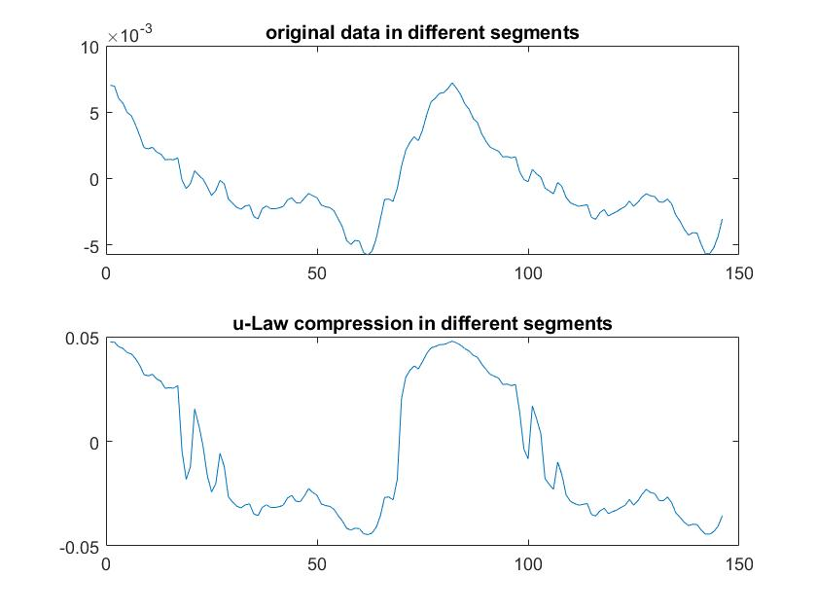
.............................................

Slide 6
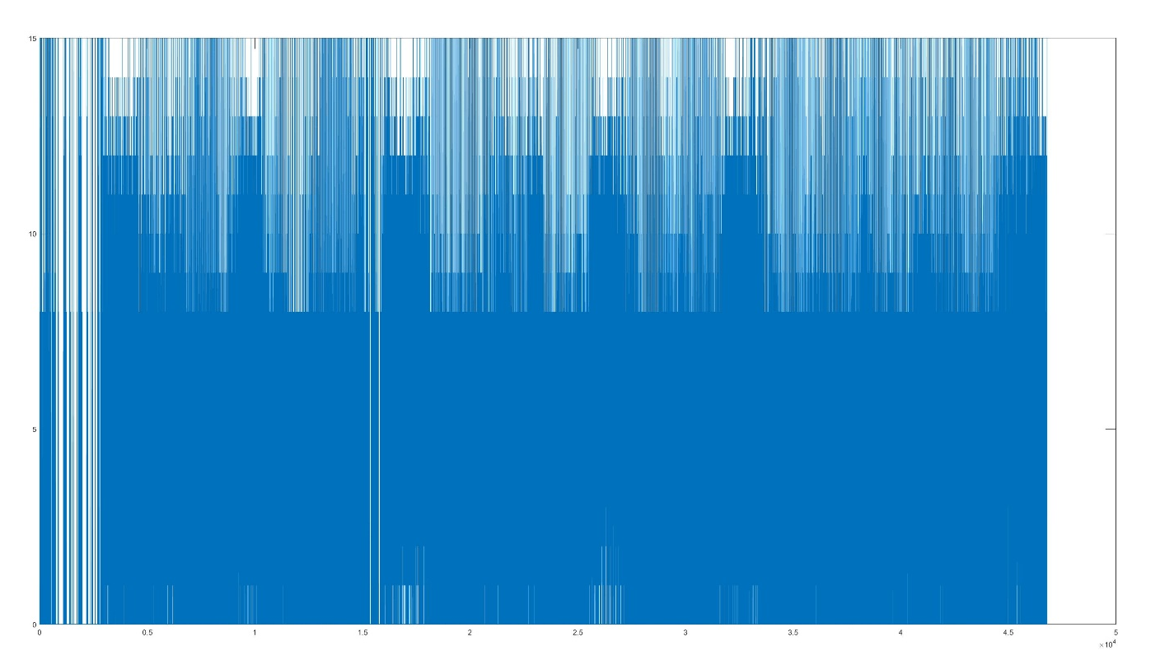

IMA ADPCM encoder encodes the input data into only 16 levels (4-bit format).
The y-axis is from 0 to 16, the x-axis is the speech signal.

Slide 7
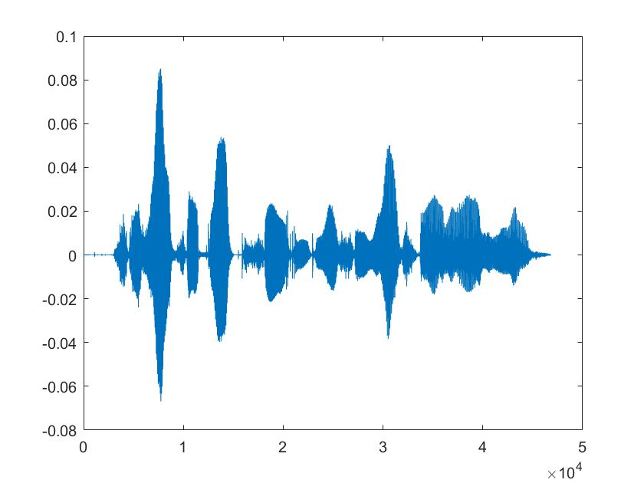
1. Read TIMIT data file into a vector x.

Slide 8
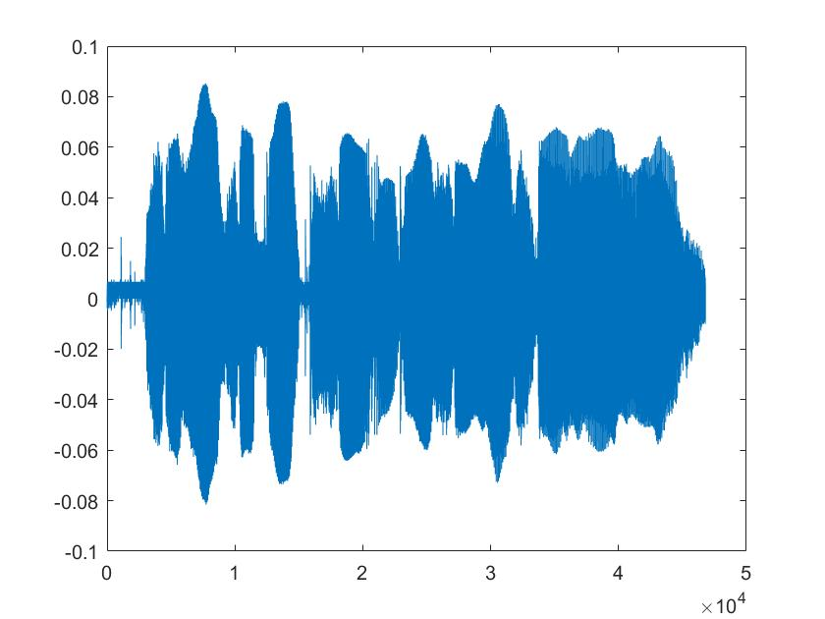
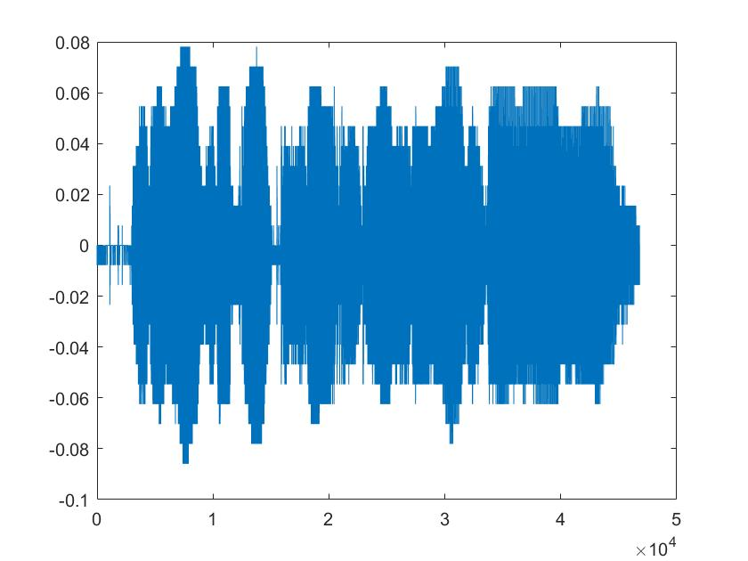
2. Apply u-Law compression to the data x that is
quantized in 16 bits and convert to an 8-bit data y.

Slide 9
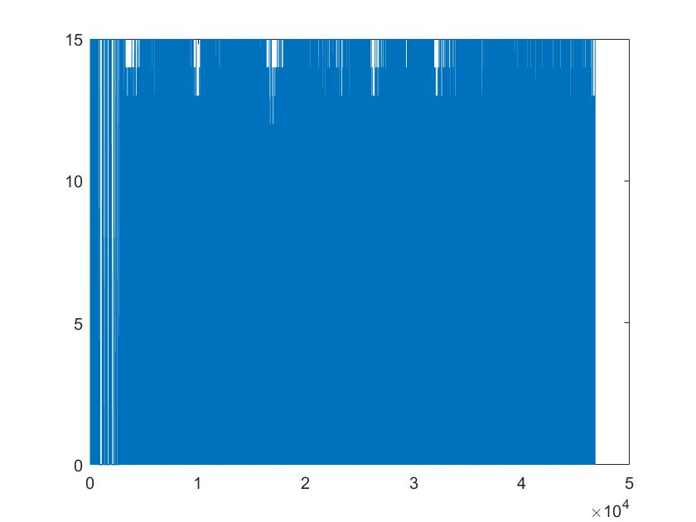
3. Apply the ADPCM Encoder to compressed data y, and obtain encoded data z.

Slide 10
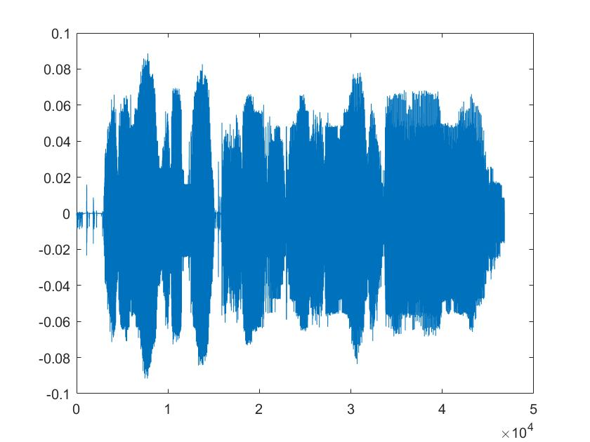
4. Apply the ADPCM Decoder to the encoded data z and obtain decoded data y’.

Slide 11
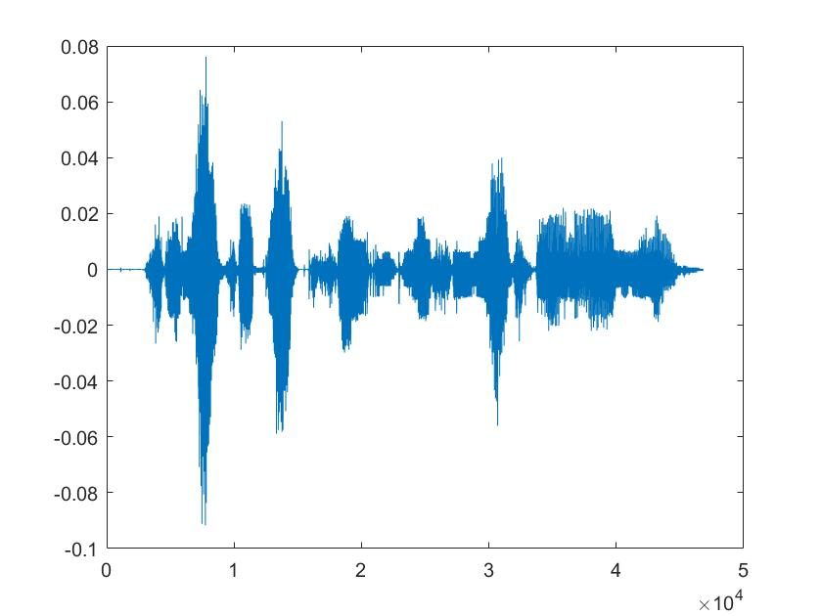


5. & 6. Apply u-Law expansion to the decoded data y’ and obtain the reconstructed speech x’. Play and plot the reconstructed speech x’.

Slide 12
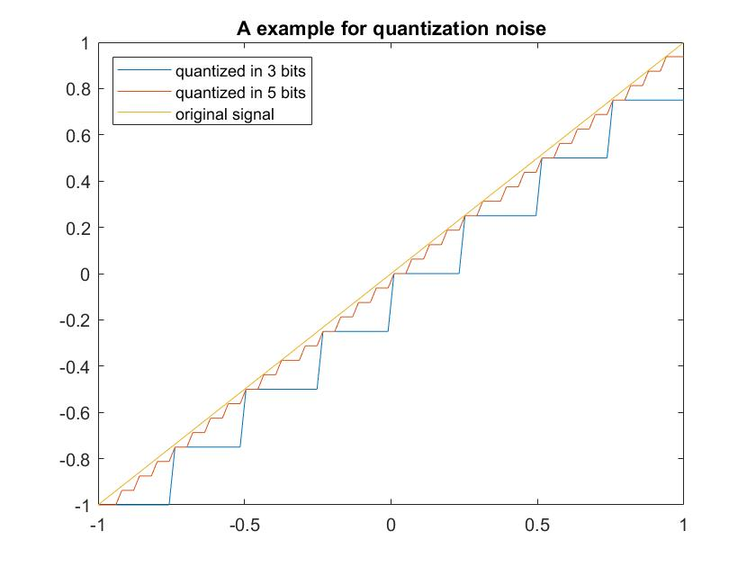
Result Analysis Why have noise?
R1
Quantization of amplitude and time
Conversion from 16 bits to 8 bits
R2
ADPCM is a lossy compression algorithm.
An example for quantization noise.
It can explain the origin quantization noise.
original
signal
quantized
5 bits
quantized
3 bits

Slide 13

References
[1] IMA Digital Audio Focus and Technical Working Groups. Recommended Practices for Enhancing Digital Audio Compatibility in Multimedia Systems, vol. 3, pp. 3-5, October 21, 1992.
[2] Sklar, Bernard. Digital Communications: Fundamentals and Applications. Englewood Cliffs, N.J.: Prentice-Hall, 1988.
[3] Cisco, Waveform Coding Techniques, Document ID:8123, February 2, 2006

Slide 14

THANK YOU
Speech and Audio Processing by Computer
Zeyu Liu

